Slide 1
Gujarat Tourism
Galore of opportunities lies here

Slide 2
Tourism Landscape of Gujarat
Beaches
Niche Tourism
Wellness Tourism
Museums
Heritage Sites
Religious Sites
Bird Watching Sites
Weekend Getaways
Eco Tourism

Slide 3
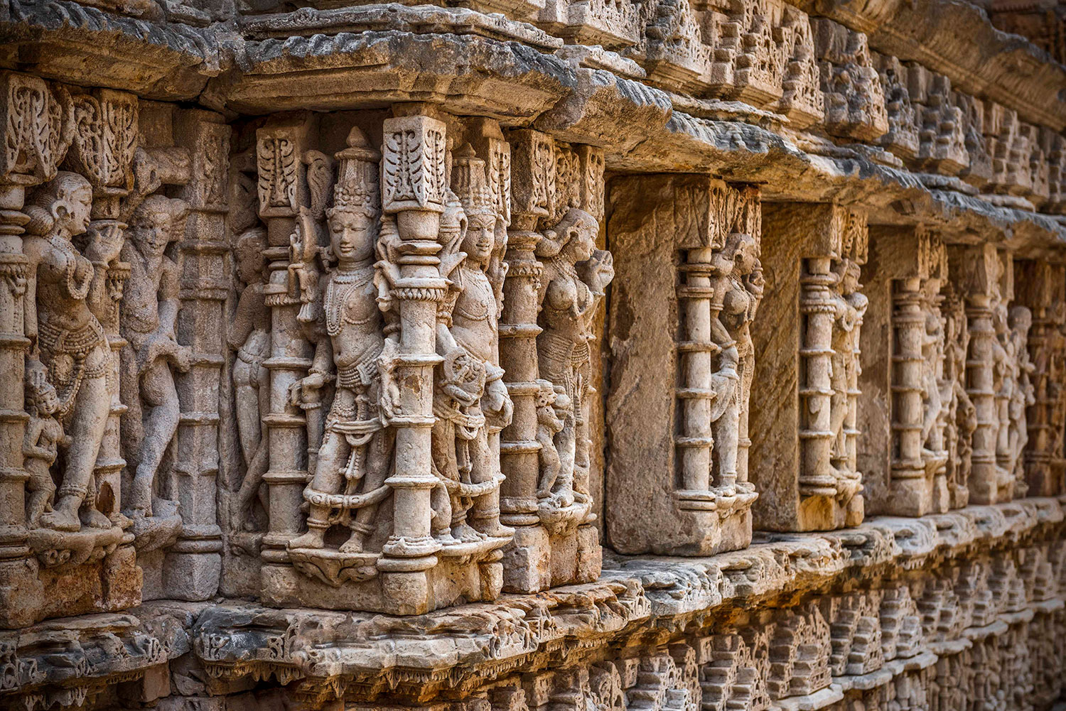
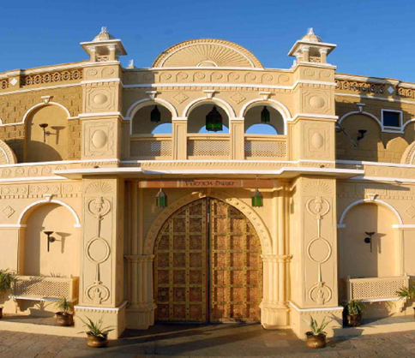
Policy Intervention
Guideline for Homestay
2014 - Ongoing
Cinematic Tourism Policy 2022-27
To provide unique experience to the tourists and boost the ecosystem
Promoting Destination and Tourism Units through films and creating demand for overall tourism industry of the State
Heritage Tourism Policy
2020-25
New Tourism Policy 2021-25
Promoting Sustainable Practices, Destination Development and Promoting MICE Tourism through incentives
Encouraging Development of Heritage Tourism Units by Incentivizing Private Investment
Increasing Supply
Demand Creation

Slide 4
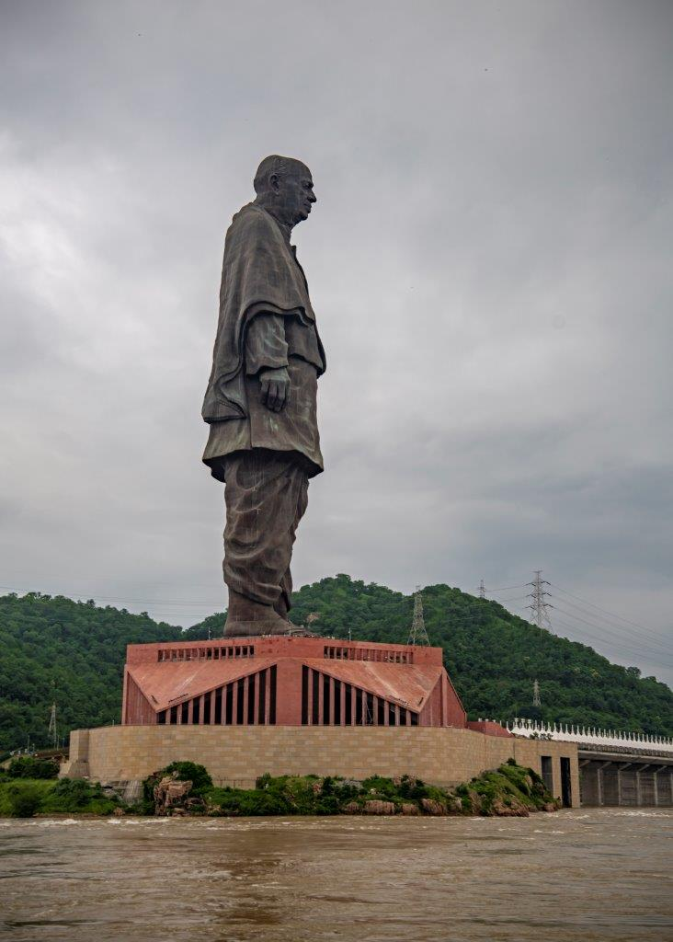
Tourist Footfall in Gujarat
Growth in last Five Years
1513 Lakh
207%
493 Lakh
2017
2022
There is 207% rise in total number of tourist footfall between 2017 and 2022

Slide 5
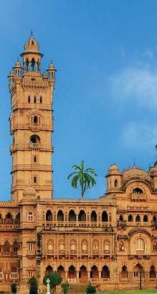
Heritage Tourism Policy 2020-2025
ELIGIBLE
BENEFICIARIES
 | Heritage Museum
To provide a unique and profound sense of the rich culture and ancient heritage to the tourists
Heritage
Hotels
Heritage Banquet
Heritage
Restaurant

Slide 6
Cinematic Tourism Policy 2022-2027
ELIGIBLE
BENEFICIARIES
Film Making
Projects
Film Infrastructure Projects
To promote and develop an ecosystem for film production industries in the state, and stimulate the tourism economy through cinematic tourism
Film Training Institute
Film or Music
Events/ Awards

Slide 7
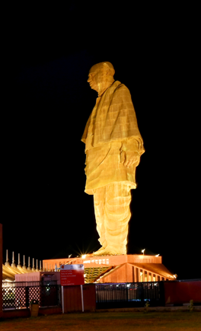
Tourism Policy
2021-2025
ELIGIBLE
BENEFICIARIES
Niche Tourism
Units
Infrastructure Projects
To position Gujarat as the foremost tourist destination in India by developing it in a sustainable, responsible, and inclusive manner, with focus on investment and livelihood opportunities
Travel and Tourism Service Providers
Skilled Manpower

Slide 8
Benefits to Registered Homestay Units
Exempted from Luxury Tax & Value Added Tax
Domestic rates for electricity are applicable
Domestic rates of municipal property tax & water tax is applicable
One-time short training as well as marketing support from TCGL
Subsidy for solar panel installation

Slide 9
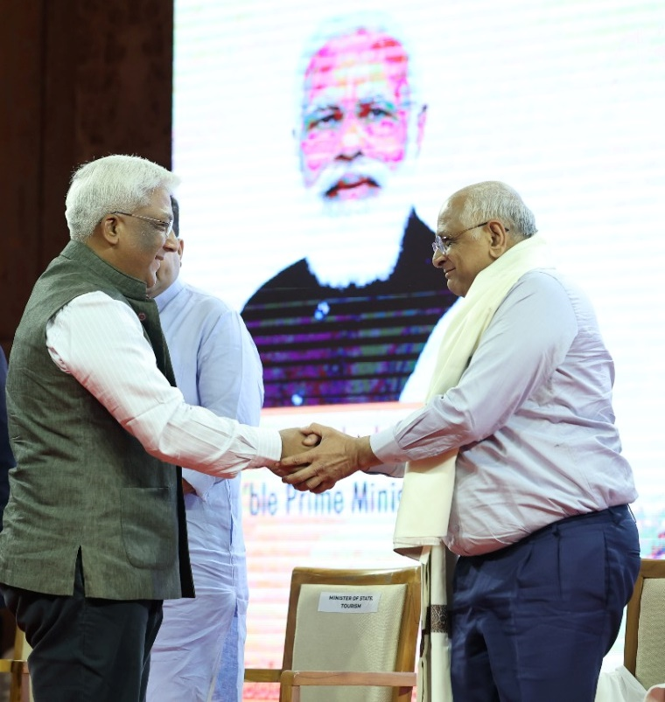
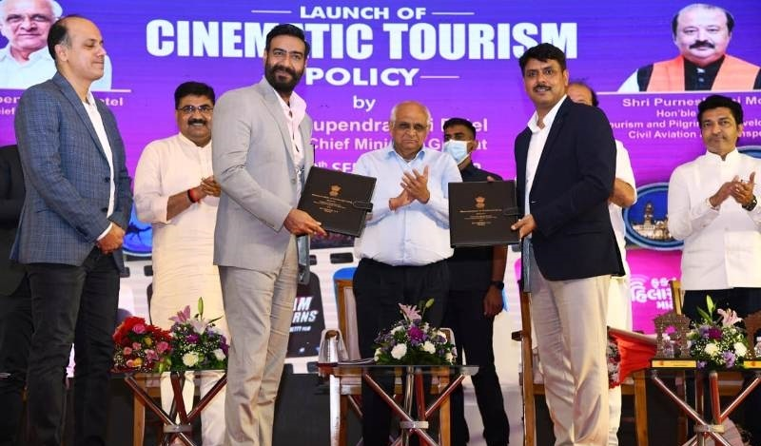
Of late Investments in the State
Launch of Heritage Tourism Policy Portal and MoU signing on 26th March 2022
Capital Investment in EoIs: INR 463.48 Crore
Cinematic Tourism Policy Launch,
10th September 2022
Capital Investment in MoUs: INR 820 Crore

Slide 10
Thank You

